Slide 1
CHATBOT AI USING PYTHON
VIGNESH VARUN.J (211420205177)
PRAKASH PAUDEL.P (211420205108)
DHANASEKAR.S (211420205040)

Slide 2
ABSTRACT
A chatbot is an artificial intelligence (AI) programme that simulates human-like dialogue with users through text or voice interfaces using natural language processing (NLP).
chatbots are employed in a wide range of sectors, including e-commerce, healthcare, and banking
With improvements in machine learning and deep learning algorithms, chatbot AI technology is continually developing, enabling more complex and individualised interactions
To overcome this difficulty, chatbot developers are continuously enhancing their algorithms and putting a lot of data to use while training their chatbots.
For a smooth user experience, they can also be combined with other technologies, like voice assistants like Amazon's Alexa or Google Assistant.

Slide 3
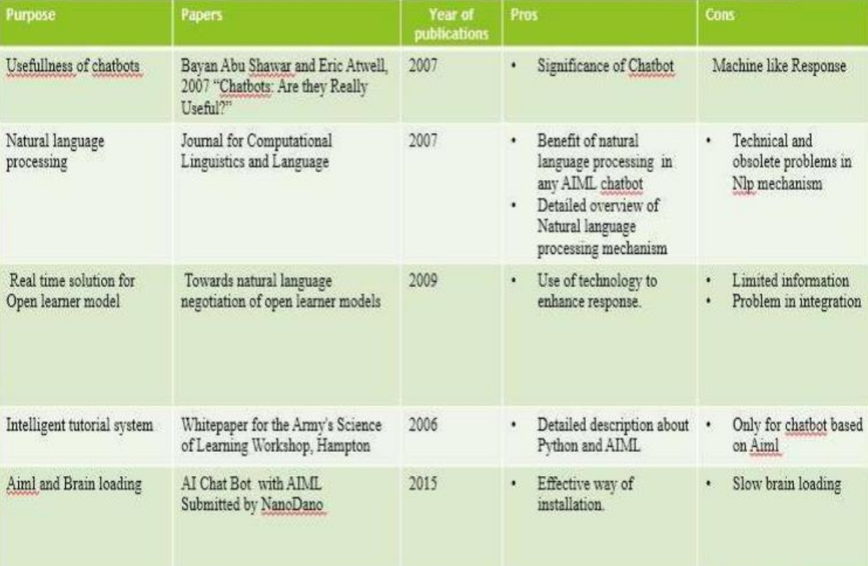
LITERATURE SURVEY

Slide 4
EXISTING SYSTEM
In the existing system ,provides response slower than the proposed system
Existing system is not interoperatable, that
It does not support in multiple os

Slide 5
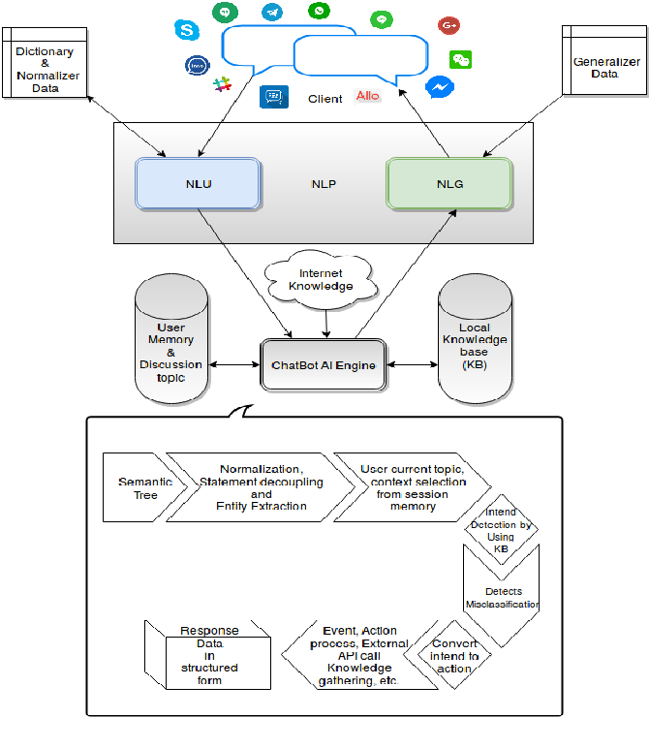
PROPOSED SYSTEM & ITS ARCHITECTURE
.

Slide 6
REQUIREMENTS
HARDWARE REQUIREMENTS
SOFTWARE REQUIREMENTS

Slide 7
HARDWARE REQUIREMENTS
CPU: MINIMUM OF I3 PROCESSOR
MEMORY: MINIMUM OF 4GB RAM IS REQUIRED
DISK STORAGE: 250GB SSD AND MIN 500GB OF HDD

Slide 8
SOFTWARE REQUIREMENTS
SUPPORTS MULTIOPERATING SYSTEMS,
WINDOWS 8/8.1/WINDOWS 10/WINDOWS 11 (64 bit)
macOS 10.15(catalina)
Any 64bit LINUX OPERATING SYSTEM ,such as ubuntu ,kalilinux,and debian based systems
LATEST VERSION OF VISUALSTUDIO CODE
PYTHON -V3 (version 3)

Slide 9
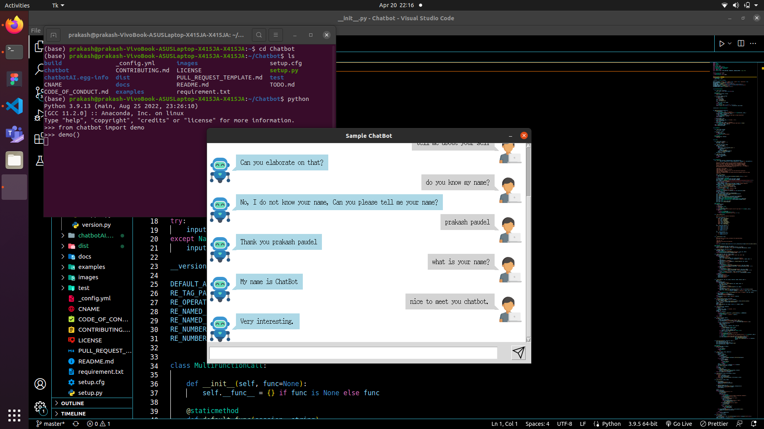
OUTPUT:

Slide 10
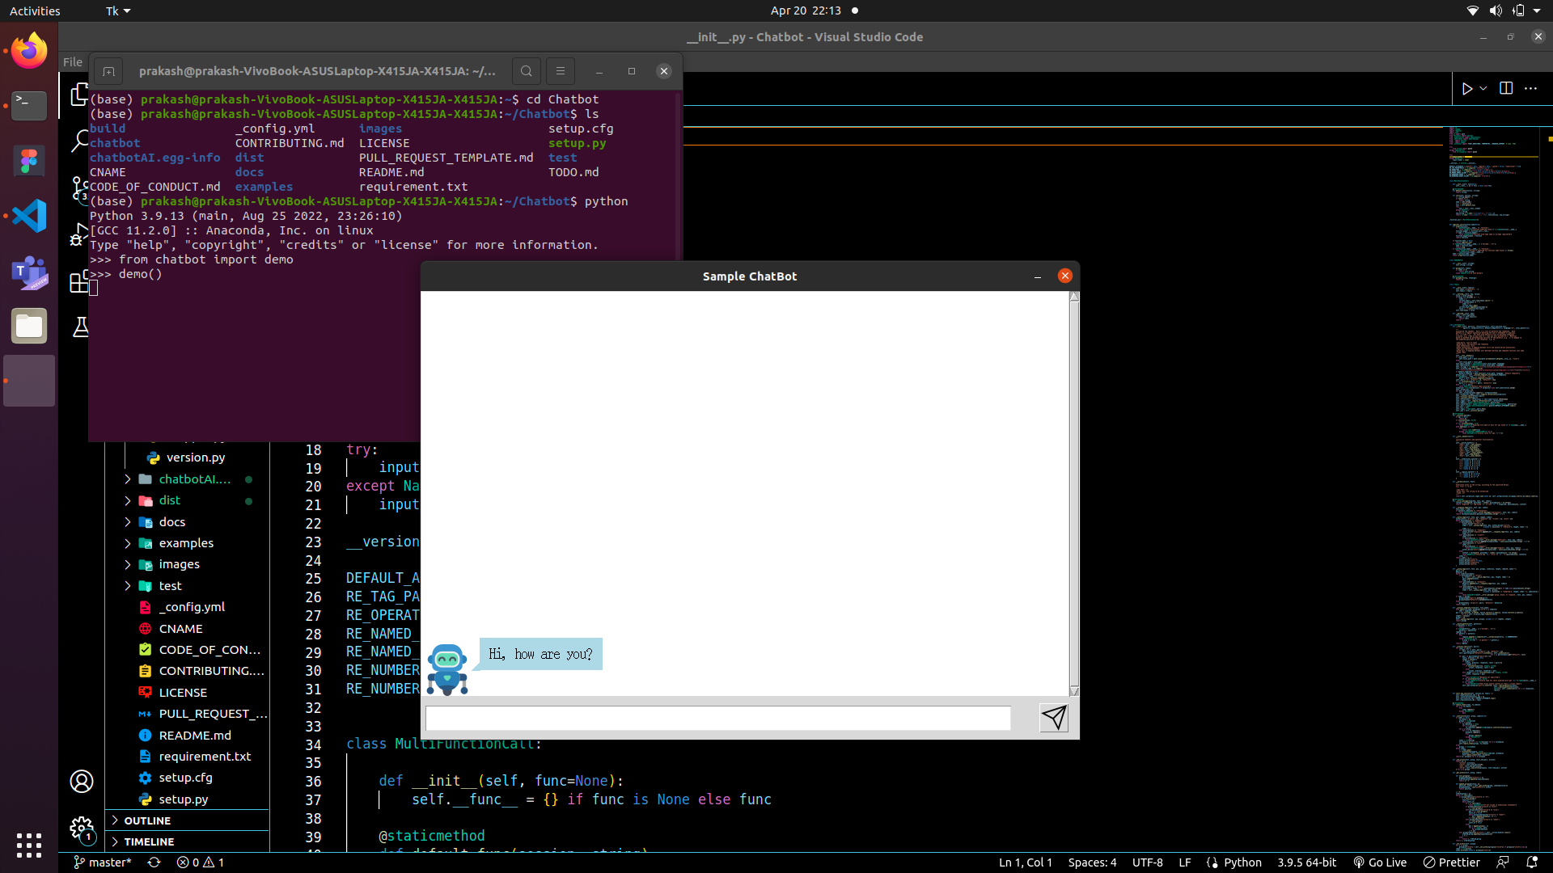
OUTPUT 2:

Slide 11
REFERENCE
Yuhua Li, David McLean, Zuhair A. Bandar, James D. O’Shea, KeeleyCrockett, “Sentence Similarity Based on Semantic Nets and CorpusStatistics”, IEEE Transactions on Knowledge and Data Engineering,Volume 18 - No. 8, August 2006
Emanuela Haller, Traian Rebedea, “Designing a Chat-bot that Simulates an Historical Figure”, IEEE Conference Publications, July 2013
Pratik Slave, Vishruta Patil, Vyankatesh Gaikwad, Girish Wadhwa, “College Enquiry Chat Bot”, International Journal on Recent and Innovation Trends in Computing and Communication, Volume 5, Issue 3, March 2015.
“AIML Based Voice Enabled Artificial Intelligent Chatterbot”,International Journal of u- and e- Service, Science and Technology Volume 8 - No. 2, 2015.
Amey Tiwari, Rahul Talekar, Prof. S. M. Patil, “College Information Chatbot System”, International Journal of Engineering Research and General Science, Volume 2, Issue 2, April 2017.

Slide 12
THANK YOU.

